Slide 1


DATA SCIENCE
with
SMALL TEAMS
Drew Fustin
PhD, Physics
Lead Data Scientist
drewfustin@gmail.com | 4.13.2017 | UChicagoGRAD Graduate Research in Data

Slide 2

DATA SCIENCE
with
SMALL TEAMS
Or:
Lots of Advice I Need to Hear and Apply Myself
drewfustin@gmail.com | 4.13.2017 | UChicagoGRAD Graduate Research in Data

Slide 3
DATA SCIENCE
with
SMALL TEAMS
Forward:
This is not an indictment of companies with limited resources. It’s a description of a challenging reality.
A reality I happen to love and find incredibly exciting.
drewfustin@gmail.com | 4.13.2017 | UChicagoGRAD Graduate Research in Data

Slide 4
DATA SCIENCE
according to Jeremy Stanley, VP of Data Science at Instacart
DECISION SCIENCE
use data to analyze business metrics — such as growth, engagement, profitability drivers, and user feedback — to inform strategy and key business decisions.
DATA PRODUCTS
use data and engineering to improve product performance, typically in the form of better search results, recommendations, and automated decisions.
drewfustin@gmail.com | 4.13.2017 | UChicagoGRAD Graduate Research in Data
Notes:
Decision Sciences should not be things that can be done without code, with off-the-shelf BI tools, or even in-house fraud detection.
If you can buy it, you probably should.
Data Products usually start with a “dumb” MVP to collect data so that you can use the data to improve and can A/B test effect size.

Slide 5
DATA SCIENCE
according to Jeremy Stanley, VP of Data Science at Instacart
DECISION SCIENCE
Wait, isn’t that BI?
The differences are blurry, but decision science shouldn’t be producing reports and dashboards. It’s often the things that go in to BI solutions beyond aggregates and KPIs. It should be things beyond what BI tools can deliver, like forecasting and clustering and other statistical and coding-based techniques.
drewfustin@gmail.com | 4.13.2017 | UChicagoGRAD Graduate Research in Data
Notes:
Decision Sciences should not be things that can be done without code, with off-the-shelf BI tools, or even in-house fraud detection.
If you can buy it, you probably should.
Data Products usually start with a “dumb” MVP to collect data so that you can use the data to improve and can A/B test effect size.

Slide 6
DATA SCIENCE
according to Jeremy Stanley, VP of Data Science at Instacart
“While decision science and data products call for some of the same skills, it’s rare for data scientists to excel at both. Decision science depends on business and product sense, systems thinking, and strong communication skills. Data products require machine learning knowledge and production-level engineering skills. If you have a small data science team, you may need to find the rare superstars who can do both. But you’ll benefit from specialization as you scale your team.”
Doing Data Science Right — Your Most Common Questions Answered [Jeremy Stanley and Daniel Tunkelang]
http://firstround.com/review/doing-data-science-right-your-most-common-questions-answered/
drewfustin@gmail.com | 4.13.2017 | UChicagoGRAD Graduate Research in Data
Notes:
Most people won’t get this and expect excellence. Managing expectations is huge.
Others will think of DS as either one or the other, not both. They’ll get confused why you are doing engineering to something that they expected was just ad hoc analysis.

Slide 7







WORKFLOW
Build decision dashboards
Create decision engines, deliver internal value
Define Need
Research Solutions
Explore Data
Code Model
Engineer Product Pipelines
Establish reqs, estimate timeline
Study methods, identify tech
Find data needed, build toy models
Architect inputs, deploy algorithms
Produce data products, customize experiences
drewfustin@gmail.com | 4.13.2017 | UChicagoGRAD Graduate Research in Data
7

Slide 8
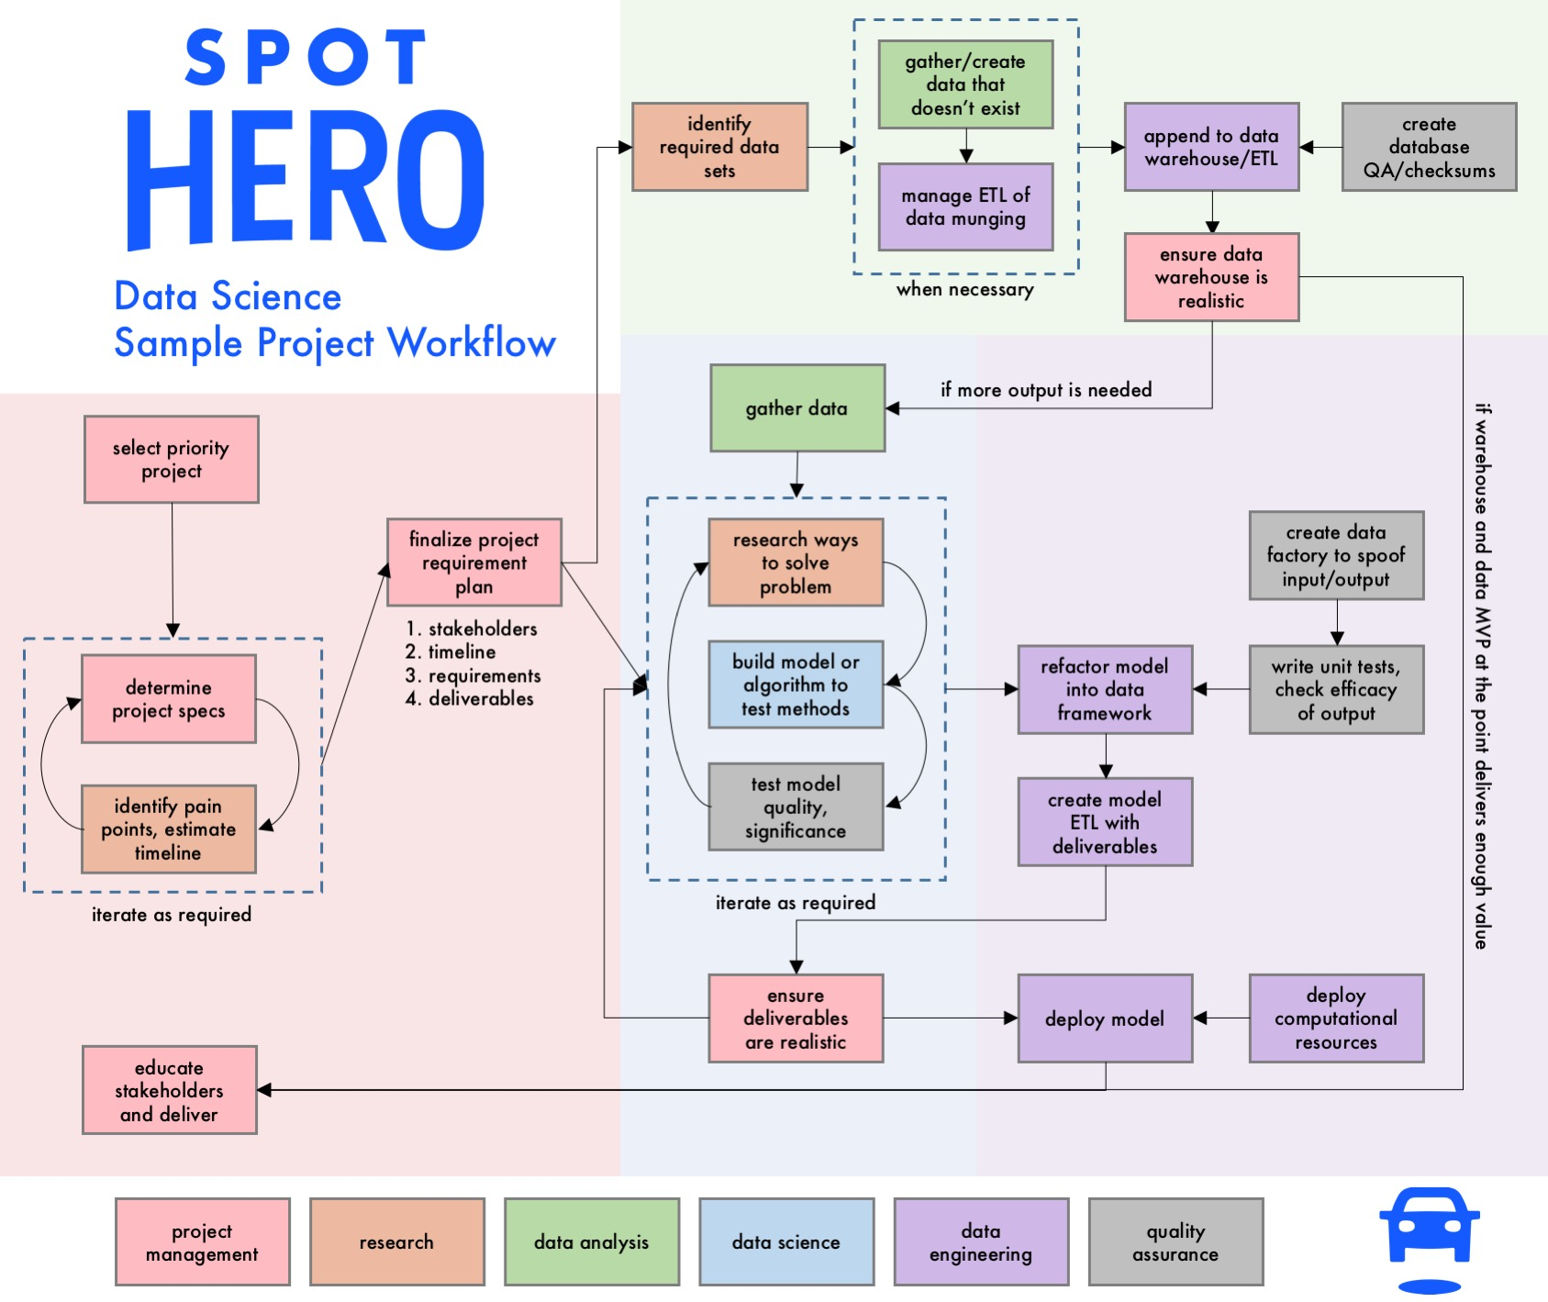
DATA
SCIENCE
IS
COMPLICATED
drewfustin@gmail.com | 4.13.2017 | UChicagoGRAD Graduate Research in Data
Notes:
Don’t focus on the flow chart (too hard to read). Just an illustration.

Slide 9
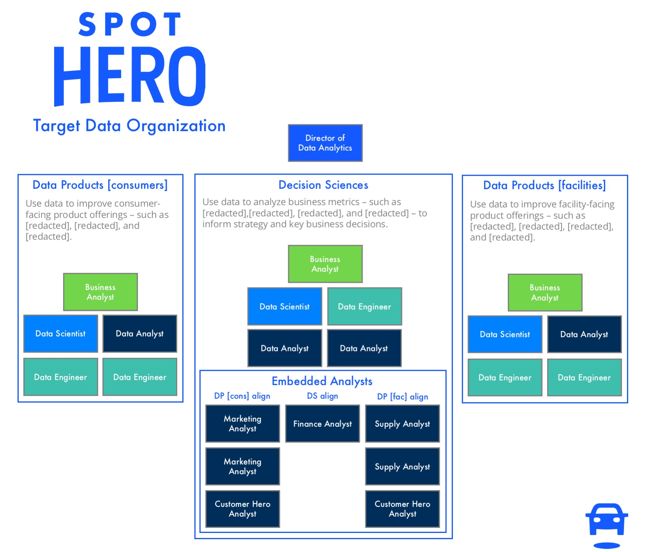
DATA
SCIENCE
IS
EASIEST WITH A
TEAM
drewfustin@gmail.com | 4.13.2017 | UChicagoGRAD Graduate Research in Data
Notes:
Org charts are different depending on lots of company dynamics.
Beyond the scope of this, but definitely read Jeremy’s post for specifics.

Slide 10
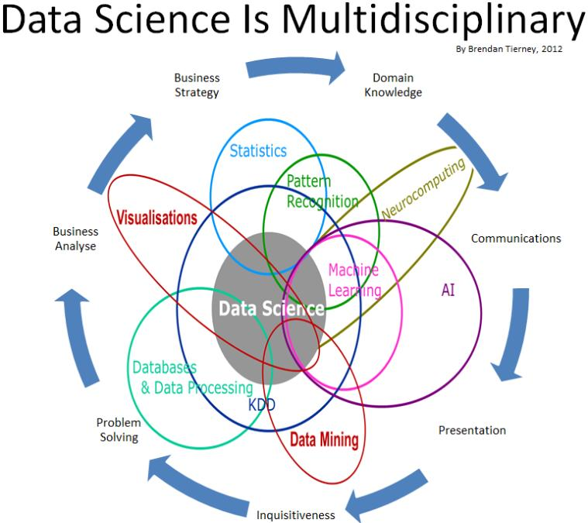
DATA
SCIENCE
IS
EASIEST WITH A
TEAM
drewfustin@gmail.com | 4.13.2017 | UChicagoGRAD Graduate Research in Data
Notes:
Venn diagram overload.

Slide 11

DATA
SCIENCE
IS
EASIEST WITH A
TEAM
drewfustin@gmail.com | 4.13.2017 | UChicagoGRAD Graduate Research in Data
Notes:
Naomi Campbell shade.

Slide 12
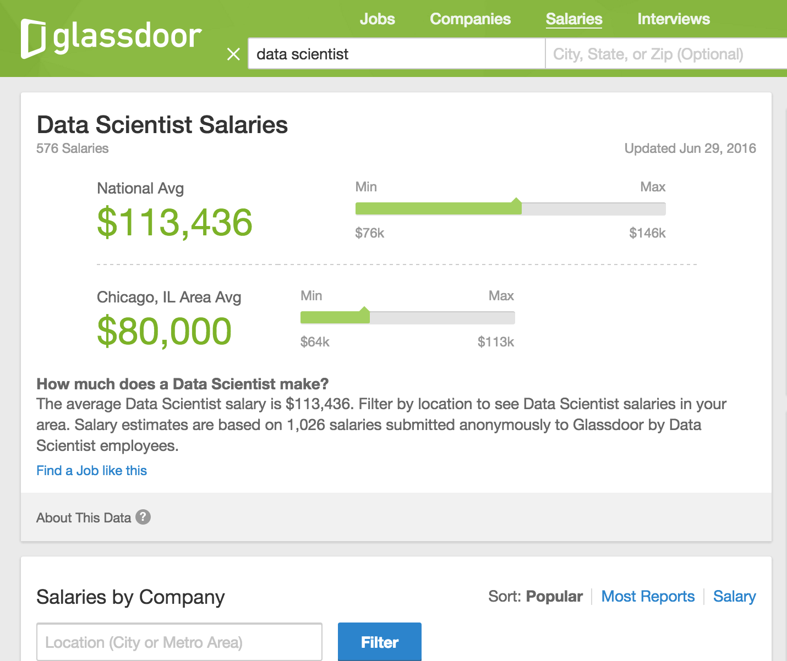
DATA
SCIENCE
IS
EXPENSIVE
drewfustin@gmail.com | 4.13.2017 | UChicagoGRAD Graduate Research in Data
Notes:
These averages are brought down by places with big DS presence.
If you really want a “small” team, you should probably pay the few you have well enough to attract possible “rock stars.”

Slide 13
DATA SCIENCE
according to Drew Conway, CEO of Alluvium
NOT ALL
VENN DIAGRAMS ARE USELESS
Hacking Skills
Math & Statistics Knowledge
Machine Learning
Data Science
Danger Zone!
Traditional Research
Substantive Expertise
drewfustin@gmail.com | 4.13.2017 | UChicagoGRAD Graduate Research in Data

Slide 14
DATA SCIENCE
according to Drew Conway, CEO of Alluvium
++
SMALL TEAM?
YOU CAN’T JUST BE A DATA SCIENTIST
You must be your own Product Manager and User Experience Researcher
Hacking Skills
Math & Statistics Knowledge
Machine Learning
Data Science
Danger Zone!
Traditional Research
Substantive Expertise
drewfustin@gmail.com | 4.13.2017 | UChicagoGRAD Graduate Research in Data
Notes:
This is almost always an unspoken expectation.
There probably isn’t someone to do this if you don’t, but it needs to be done.
In fact, small teams are usually new to a company, so managing expectations is more important now than with a developed team.

Slide 15
DATA SCIENCE
according to Drew Conway, CEO of Alluvium
++
SMALL TEAM?
YOU CAN’T JUST BE A DATA SCIENTIST
You must be your own Product Manager and User Experience Researcher
Hacking Skills
Math & Statistics Knowledge
Machine Learning
Data Science
Danger Zone!
Traditional Research
Substantive Expertise
Sorry, but… 20% goes to COMMUNICATION
drewfustin@gmail.com | 4.13.2017 | UChicagoGRAD Graduate Research in Data
Notes:
Anecdote about eventually doing daily standups to ensure communication was on track.

Slide 16
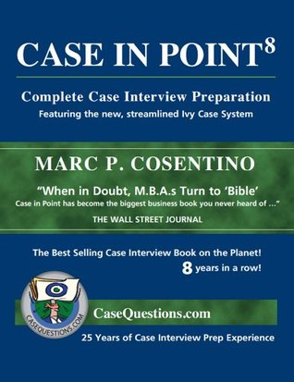
PM + UX
FROM ACADEMIA?
Learn to speak
strategy and business
GROSS MARGIN, KPIs, LTV, CAC, ATTRIBUTION, ROI, RETENTION, ATTRITION, MONTHS-TO-PAYBACK, blah blah blah
drewfustin@gmail.com | 4.13.2017 | UChicagoGRAD Graduate Research in Data
Notes:
Studying for potential strat consulting job (phew) was surprisingly useful for when I joined a consumer web company.
Most people coming out of academia/undergrad/data science degree programs will not have this understanding.
A good way to set yourself apart: understand how their business works and high-level thoughts on their paint points and how to make business better.

Slide 17
PM + UX
according to Arthur Geoffrion, UCLA Anderson School of Management
RESERVE THE RIGHT
OF PROBLEM FORMULATION
Maxims for Modelers [Arthur Geoffrion]
http://www.anderson.ucla.edu/faculty/art.geoffrion/home/docs/Gudmdlg2.htm
drewfustin@gmail.com | 4.13.2017 | UChicagoGRAD Graduate Research in Data
Notes:
Most stakeholders don’t know what they actually want – they don’t even know what’s possible! This is not their training. It’s yours.
It’s on you to formulate the problem that solves their needs. Early communication to make sure you don’t waste time in rabbit holes is huge.
You think they want a complex seasonal ARIMA with holiday corrections, but really, they want a line drawn in an automated way.

Slide 18
PM + UX
according to Arthur Geoffrion, UCLA Anderson School of Management
DEVELOP A CLEAR CHARTER
AND PROJECT PLAN
Maxims for Modelers [Arthur Geoffrion]
http://www.anderson.ucla.edu/faculty/art.geoffrion/home/docs/Gudmdlg2.htm
drewfustin@gmail.com | 4.13.2017 | UChicagoGRAD Graduate Research in Data
Notes:
Document the project business opportunity, expectations, deliverables, definition of done, timelines, assumptions/risks/dependencies at the start.
Scope creep will happen, but most don’t understand scope creep from an engineering side of things (one in, one out).
They expect additional things will get done as “above and beyond,” even if impossible.
Setting expectations ahead of time in writing while help future arguments on additional features and timelines.

Slide 19
PM + UX
according to Arthur Geoffrion, UCLA Anderson School of Management
FIND A HIGH-LEVEL CHAMPION
Maxims for Modelers [Arthur Geoffrion]
http://www.anderson.ucla.edu/faculty/art.geoffrion/home/docs/Gudmdlg2.htm
drewfustin@gmail.com | 4.13.2017 | UChicagoGRAD Graduate Research in Data
Notes:
Either find someone who makes decisions who gets data and why it’s important,
or find a sympathetic ear and teach them to get it.
You probably won’t be that person if it’s an early/small DS team because it’s not ingrained in exec that this is anything more than analysis/engineering.

Slide 20
PM + UX
according to Arthur Geoffrion, UCLA Anderson School of Management
ESTABLISH PERSONAL CREDIBILITY
AND PRODUCE RESULTS EARLY
Maxims for Modelers [Arthur Geoffrion]
http://www.anderson.ucla.edu/faculty/art.geoffrion/home/docs/Gudmdlg2.htm
drewfustin@gmail.com | 4.13.2017 | UChicagoGRAD Graduate Research in Data
Notes:
First impressions are key. If they don’t trust you will produce, you’ll get no leeway in (e.g.) scope creep arguments later.
Also, they won’t believe what you give is valuable and won’t even use it necessarily.
Then, well, you might not have a job.
You must be trusted and respected.

Slide 21
PM + UX
according to Arthur Geoffrion, UCLA Anderson School of Management
INVOLVE THE STAKEHOLDER
AND FUTURE USERS AT ALL STAGES
Maxims for Modelers [Arthur Geoffrion]
http://www.anderson.ucla.edu/faculty/art.geoffrion/home/docs/Gudmdlg2.htm
drewfustin@gmail.com | 4.13.2017 | UChicagoGRAD Graduate Research in Data
Notes:
I have what I call a Primary Stakeholder who is the go-to decision maker on what needs done.
Then I have an Analytical Point who is the one who understands the topic and is analytically minded, so they can discuss the nitty gritty.
I meet with the Analytical Point at least once a week. Primary Stakeholder only when necessary.
Unless of course pain points in communication develop. Then increase frequency.

Slide 22
PM + UX
according to Arthur Geoffrion, UCLA Anderson School of Management
COMMUNICATE OFTEN AND WELL
Maxims for Modelers [Arthur Geoffrion]
http://www.anderson.ucla.edu/faculty/art.geoffrion/home/docs/Gudmdlg2.htm
drewfustin@gmail.com | 4.13.2017 | UChicagoGRAD Graduate Research in Data
Notes:
Think an hour a day just writing emails will just get in the way of being an individual contributor? It is not.
Asymmetric information. You think writing out what’s in your head is mundane and obvious because it’s in your head.
Others don’t know it. They probably want to. Explain it to them early and often. “My algorithm first takes GA, then looks for coupon code usage, then…”

Slide 23
OUR GOAL
FOCUS or EXPAND
when it works to stay small
provide a customer solution
and iteratively add features to this solution to expand product
when scale is needed to be impactful
eventually grow a team of complementary parts to allow for increased scope
drewfustin@gmail.com | 4.13.2017 | UChicagoGRAD Graduate Research in Data
Notes:
Focus: SaaS or embedded Decision Science. The “don’t do too many things at once” model.
Expand: Big, big dreams that are impossible without much larger resources. So, set the stage now and establish credibility so you can build.

Slide 24
FOCUS
e.g. SaaS Data Product or Marketing Optimization Decision Science
CRITICAL: DON’T DO TOO MANY THINGS Understand through UX and set expectations of stakeholders to deliver exactly what is needed.
Nothing more.
drewfustin@gmail.com | 4.13.2017 | UChicagoGRAD Graduate Research in Data
Notes:
Often, Focus-aligned jobs are things that are embedded decision science things.
The UX feedback loop is key and needs to be frequently cycled through. This is why “communication” is so important for these types of jobs.
Discover what the user wants. Deliver a feature. Discover another thing they want on top. Deliver that feature.
Can keep iterating on this for a long time without expanding.

Slide 25
FOCUS
e.g. SaaS Data Product or Marketing Optimization Decision Science
UNIT TEST ALL THE THINGS While unit tests are always important,
when a product is built iteratively, they are necessary.
Have data factories to spoof typical/edge case data.
drewfustin@gmail.com | 4.13.2017 | UChicagoGRAD Graduate Research in Data
Notes:
Since you’re building Roman cities on top of each other, a new feature could easily break every other feature. Don’t let it.
Data factories are just (e.g.) dictionaries with data fields that can be passed through your process to see how they come out.
“What happens if the payment processor fee is missing? Does my code break?”

Slide 26
FOCUS
e.g. SaaS Data Product or Marketing Optimization Decision Science
DOUBLE THE DOCUMENTATION Explain the process technically (for future you)
and accurately but simply (for the consumer)
drewfustin@gmail.com | 4.13.2017 | UChicagoGRAD Graduate Research in Data
Notes:
Jupyter is awesome for documentation.
Idea: produce one Jupyter document with both blog-like explanation and detailed code, and just remove the code parts for the consumer.

Slide 27
EXPAND
e.g. Recommendation Engines + Attribution Models + Routing Algorithms + …
CRITICAL: QUICK TO “GOOD ENOUGH” You need to scale the team to be effective,
so produce small, easy wins to earn favor and budget.
Think Pareto’s principle: 80% quality at 20% time cost.
drewfustin@gmail.com | 4.13.2017 | UChicagoGRAD Graduate Research in Data
Notes:
The name of the game is “prove value of data science” as early and frequently as you can.
Then it’s easy to say, “We could do that if we had more resources,” and your wish will be granted.
If you aren’t delivering frequently, it’ll be a hard sell to get expansion bought into.
80% done seems like a bad solution? This isn’t academia. Is it better than what’s in place now? Ship it.

Slide 28
EXPAND
e.g. Recommendation Engines + Attribution Models + Routing Algorithms + …
GET DATA MVPs INTO PRODUCTION Many Data Products require lots of user data,
so get an MVP out to start collecting,
and wait to improve.
drewfustin@gmail.com | 4.13.2017 | UChicagoGRAD Graduate Research in Data
Notes:
Think recommendation systems.
MVP: “You recently bought this. Buy it again!” Next step: ”People like you bought this. You should try it!” A/B test if people buy more now.
Data products like this are often a data feedback loop that needs enough to start on.

Slide 29
EXPAND
e.g. Recommendation Engines + Attribution Models + Routing Algorithms + …
BE A PRETTY GOOD DATA ENGINEER Projects are often standalone,
so have a reliable ETL process to reduce upkeep.
Upkeep time budget will increase over time.
drewfustin@gmail.com | 4.13.2017 | UChicagoGRAD Graduate Research in Data
Notes:
If you work on many different projects in succession, the worst thing to do will be having to go and revisit old work over and over while working on new things.
The context switch and re-familiarizing that will take up more time than you think. You can slow to a crawl.
If the process of delivering is well-oiled and stable, you shouldn’t have to revisit much unless you’re adding a feature (which is a new project!).

Slide 30
DATA SCIENCE
according to Drew Conway, CEO of Alluvium
++
SMALL TEAM?
YOU CAN’T JUST BE A DATA SCIENTIST
You must be your own Product Manager and User Experience Researcher
Hacking Skills
Math & Statistics Knowledge
Machine Learning
Data Science
Danger Zone!
Traditional Research
Substantive Expertise
drewfustin@gmail.com | 4.13.2017 | UChicagoGRAD Graduate Research in Data

Slide 31
DATA SCIENCE
according to Drew Conway, CEO of Alluvium
++++
SMALL TEAM?
YOU CAN’T JUST BE A DATA SCIENTIST
You must be your own Product Manager and User Experience Researcher
and Data Engineer and QA Test Engineer
Hacking Skills
Math & Statistics Knowledge
Machine Learning
Data Science
Danger Zone!
Traditional Research
Substantive Expertise
drewfustin@gmail.com | 4.13.2017 | UChicagoGRAD Graduate Research in Data

Slide 32
DATA SCIENCE
according to Drew Conway, CEO of Alluvium
++++
SMALL TEAM?
YOU CAN’T JUST BE A DATA SCIENTIST
You must be your own Product Manager and User Experience Researcher
and Data Engineer and QA Test Engineer
+
+
Math & Statistics Knowledge
+
Hacking Skills
Machine Learning
+
+
Data Science
+
+
Danger Zone!
Traditional Research
Substantive Expertise
drewfustin@gmail.com | 4.13.2017 | UChicagoGRAD Graduate Research in Data
Notes:
And probably a bunch of other things too.

Slide 33

AN ASIDE
drewfustin@gmail.com | 4.13.2017 | UChicagoGRAD Graduate Research in Data

Slide 34
AN ASIDE
Lest you feel overwhelmed:
You don’t have to be great at all of this.
drewfustin@gmail.com | 4.13.2017 | UChicagoGRAD Graduate Research in Data

Slide 35
AN ASIDE
Lest you feel overwhelmed:
You don’t have to be great at all of this.
The beauty of being part of a small team is that
what you contribute is probably going to be
significantly better than what already exists.
drewfustin@gmail.com | 4.13.2017 | UChicagoGRAD Graduate Research in Data

Slide 36
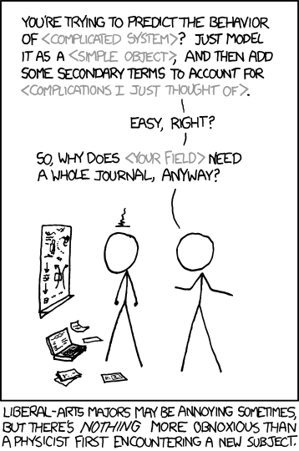
ALSO…
DON’T BE A PHYSICIST.
PEOPLE WHO ACTUALLY DO THESE JOBS?
THEY’RE BETTER THAN YOU AT DOING THEM.
https://xkcd.com/793/
drewfustin@gmail.com | 4.13.2017 | UChicagoGRAD Graduate Research in Data

Slide 37
REMINDER:
drewfustin@gmail.com | 4.13.2017 | UChicagoGRAD Graduate Research in Data

Slide 38
REMINDER:
DATA
SCIENCE
IS
COMPLICATED
drewfustin@gmail.com | 4.13.2017 | UChicagoGRAD Graduate Research in Data

Slide 39
REMINDER:
DATA
SCIENCE
IS
COMPLICATED
TRY YOUR BEST TO BE YOUR OWN:
DATA SCIENTIST
DATA ENGINEER
QA TEST ENGINEER
PRODUCT MANAGER
UX RESEARCHER
drewfustin@gmail.com | 4.13.2017 | UChicagoGRAD Graduate Research in Data

Slide 40
REMINDER:
DATA
SCIENCE
IS
COMPLICATED
TRY YOUR BEST TO BE YOUR OWN:
DATA SCIENTIST
DATA ENGINEER
QA TEST ENGINEER
PRODUCT MANAGER
UX RESEARCHER
¯\_(ツ)_/¯
drewfustin@gmail.com | 4.13.2017 | UChicagoGRAD Graduate Research in Data

Slide 41
DATA SCIENCE
with
SMALL TEAMS
“While decision science and data products call for some of the same skills, it’s rare for data scientists to excel at both. Decision science depends on business and product sense, systems thinking, and strong communication skills. Data products require machine learning knowledge and production-level engineering skills. If you have a small data science team, you may need to find the rare superstars who can do both. But you’ll benefit from specialization as you scale your team.”
Jeremy Stanley and Daniel Tunkelang
drewfustin@gmail.com | 4.13.2017 | UChicagoGRAD Graduate Research in Data

Slide 42
FURTHER READING
Doing Data Science Right — Your Most Common Questions Answered [Jeremy Stanley and Daniel Tunkelang]
http://firstround.com/review/doing-data-science-right-your-most-common-questions-answered/
Maxims for Modelers [Arthur Geoffrion]
http://www.anderson.ucla.edu/faculty/art.geoffrion/home/docs/Gudmdlg2.htm
Highly Effective Data Science Teams [Drew Harry]
https://medium.com/mit-media-lab/highly-effective-data-science-teams-e90bb13bb709
The Startup Founder’s Guide to Analytics [Tristan Handy]
https://thinkgrowth.org/the-startup-founders-guide-to-analytics-1d2176f20ac1
Data Science Team-Building and Optimization (talk) [Jeremy Stanley]
https://www.youtube.com/watch?v=CqQyrkEvh_8
drewfustin@gmail.com | 4.13.2017 | UChicagoGRAD Graduate Research in Data

